Slide 1
A New Lens for Understanding Control Efficacy
March 26, 2025

Slide 2
How much risk reduction did your organization get from its most recent large security investment?
If your security department had its budget cut, how confident would it be in deciding what to cut?

Slide 3
The gap…

Slide 4
The Challenge We All Face
We know which controls we’ve implemented (anatomy)
We don’t understand how they function to reduce risk (physiology)
We can’t reliably measure their effectiveness
We make decisions based on intuition rather than measurement

Slide 5
“In the 1800’s medicine had a relatively advanced understanding of anatomy, but we had a terrible understanding of physiology.
We knew what was happening, but we didn’t understand why it was happening.”
A Retired Surgeon

Slide 6
In the practice of medicine, which is more important?
Anatomy?
(The parts of the system)
Physiology?
(How the system works)
OR
Neither. You need to know both.

Slide 7
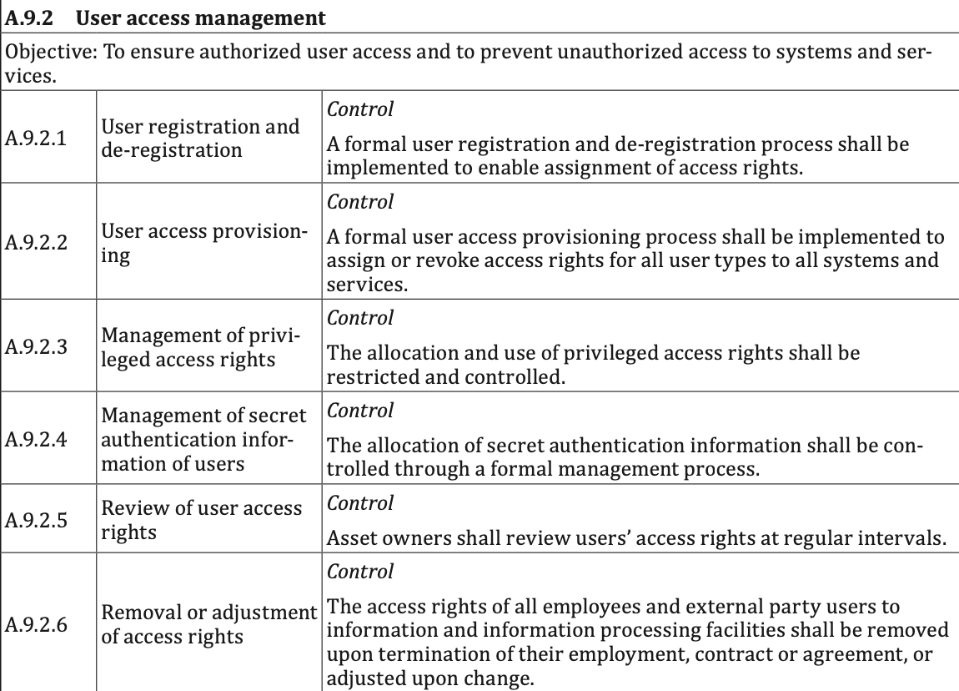
Example of cybersecurity “anatomy” (ISO27001)

Slide 8
Human Anatomy vs. Physiology
Anatomical component: Spleen
Size: Approximately 1 x 3 x 5 inches
Weight: Approximately 7 oz
Location: Upper-left abdomen
Purpose: Helps to fight infections
Physiology
Function: Blood filtering via white pulp and red pulp
Depends upon: Arteries, veins, nerves, lungs, etc…
Is depended upon by: Liver, brain, etc…
When missing or damaged is partially compensated for by: Lymph nodes, etc…
In other words, it’s part of a system.

Slide 9
Cybersecurity Anatomy vs. Physiology
Anatomical component: Awareness training
Content: Passwords, phishing, clean desk, etc.
Periodicity: Annual
Purpose: Informs personnel about the organization’s expectations and requirements.
Physiology (how it functions within the system to reduce risk)
Function: Reduces the frequency of decisions and actions that introduce additional, undesirable levels of risk
Depends upon: Policies, risk appetite, risk measurement, etc…
Is depended upon by: Authentication, system security, access privileges, physical security, data protection, etc…
When deficient, may be partially compensated for by: DLP, password enforcement, Anti-malware, etc.
It’s part of a system.

Slide 10
The Missing Piece…
A model for understanding how controls actually function
A means to account for how controls work together as a system
A way to empirically measure control efficacy
An ability to quantify the value of our investments

Slide 11
Filling the gap…

Slide 12
What is FAIR-CAM?
Factor Analysis of Information Risk - Control Analytics Model
An extension of FAIR focused on measuring control efficacy
A model for understanding control “physiology”
NOT just another control framework

Slide 13
Which enables…
…informed, cost-effective decisions about controls

Slide 14
FAIR-CAM’s Three Domain Structure
Directly affect the frequency or magnitude of loss
Indirectly affect risk
Enable well-informed decisions
Asset management
Threat intelligence
Awareness training
Risk analysis
Policies
Etc.
Decision Support Control Functions
Authentication
Access privileges
Logging
Data recovery processes
Etc…
Assets
Loss Event Control Functions
Controls
Risk
Variance Management Control Functions
Scanning
Patching
Auditing
Change management
Etc…
Threats
Affect the reliability of other controls

Slide 15
What’s the efficacy of personnel as a control against phishing?
Asset management
Threat intelligence
Anti-phishing training
Risk analysis
Etc.
Decision Support Control Functions
Personnel
Anti-malware
Access privileges
Data recovery processes
Etc…
Assets
Loss Event Control Functions
Risk
Ransomware outage via phishing
Controls
Variance Mgmt. Control Functions
Scanning
Anti-phishing testing
Auditing
Change management
Etc…
Threats

Slide 16
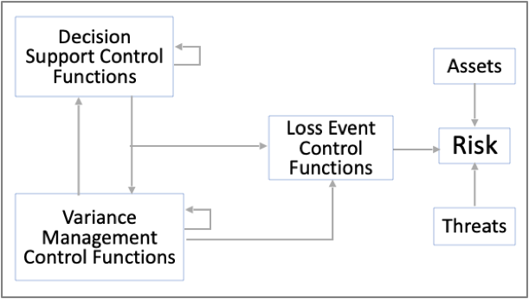
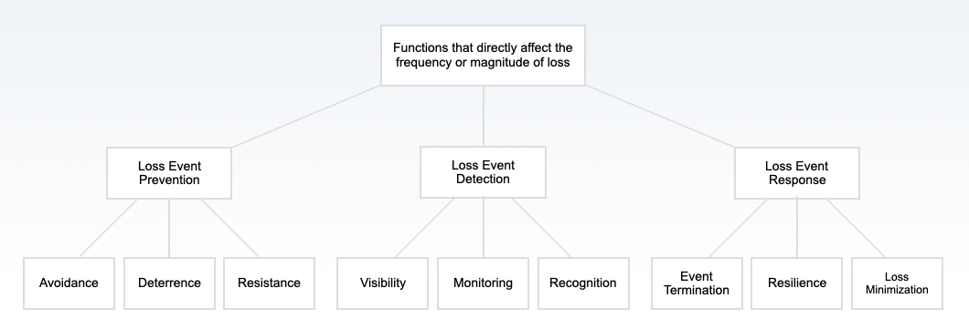
Loss Event Control Functions
%
%
%
%
Frequency
%
Time
Time
$
Authentication?
Logs?
Patching?
WAF?

Slide 17
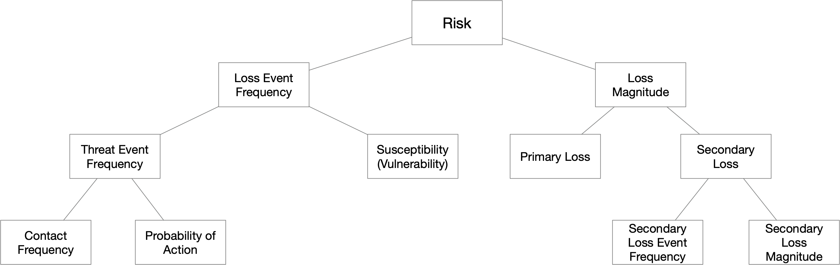
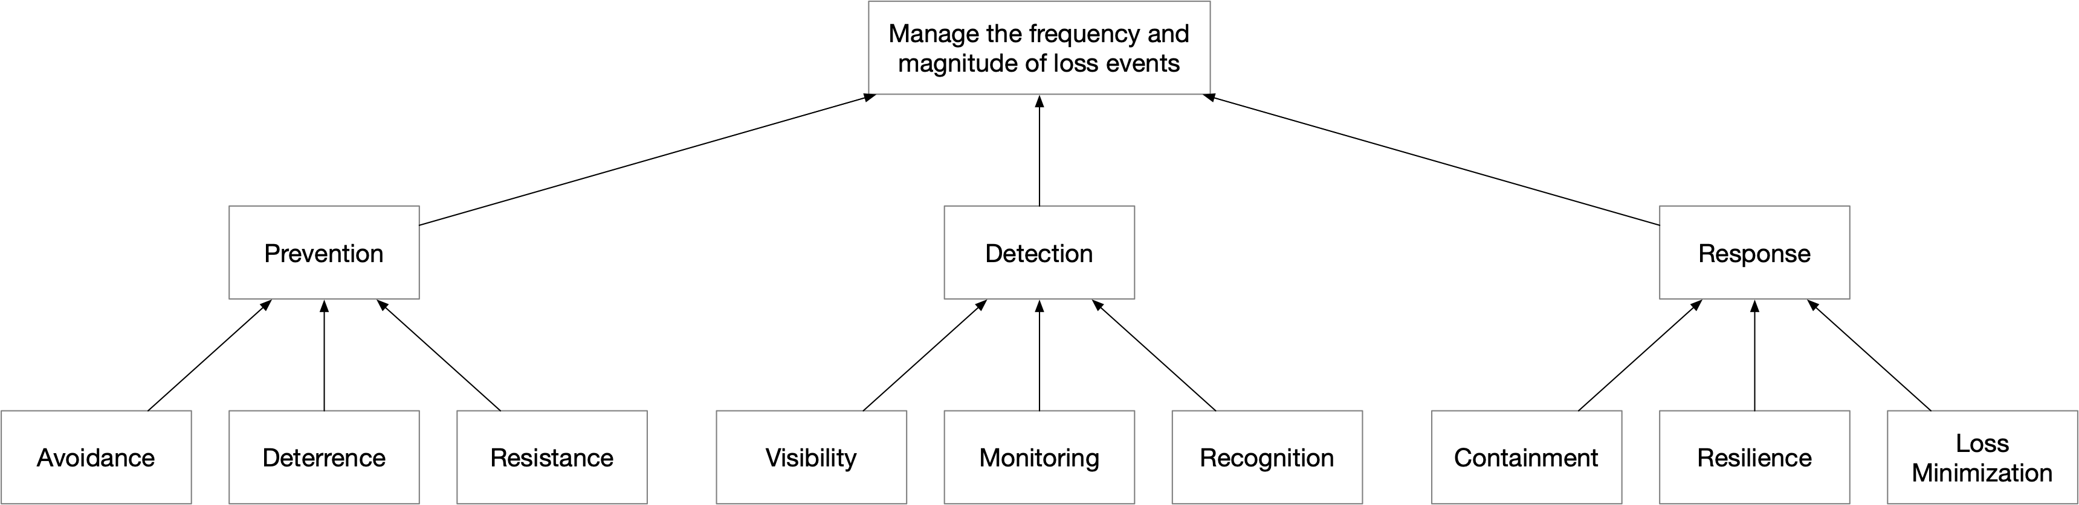
Loss Event Function Mapping to Risk
FAIR
FAIR-CAM
Loss Event Functions

Slide 18
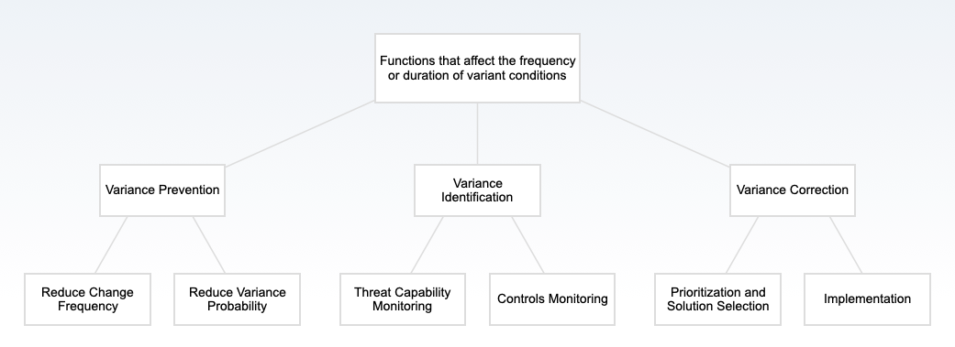
Variance Management Control Functions
Restricting Admin Privileges?
Vuln scanning?
Threat Intelligence?
Patching?

Slide 19
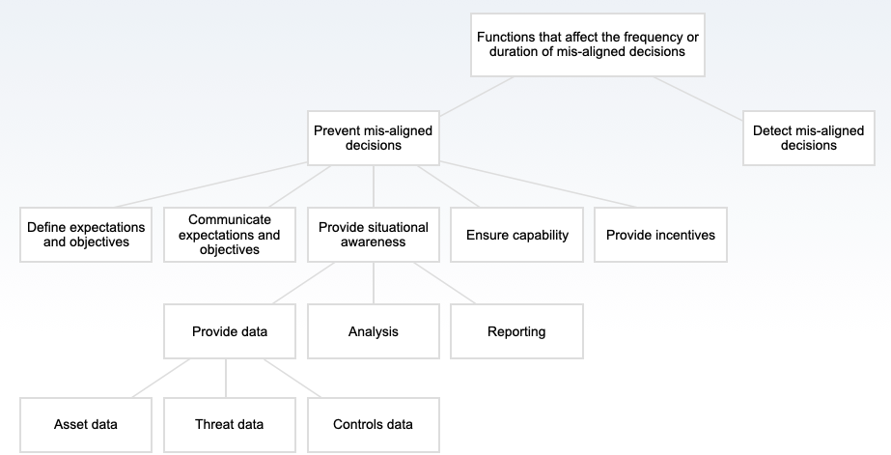
Decision Support Control Functions

Slide 20
Understanding Efficacy

Slide 21
Example of typical control “measurement”
NOT quantitative values!
“3”
“4”
“4”
“1”
“4”
“4”
“4”
“5”
“2”
“3”
“2”
“2”
Avg.
=?
3.17
3.17

Slide 22
Three states of control efficacy
Intended efficacy — how well a control works when operating as designed
Variant efficacy — how well a control works when in a degraded condition
Operational efficacy — the actual performance over time
A function of intended efficacy, variant efficacy, and variance patterns

Slide 23
Understanding “Variance”
A “variant condition” exists when a control is not operating at its intended level of efficacy. For example:
A weak password
Logging that is not enabled
A system that has not been configured properly
Vulnerability scanning that does not take place when its supposed to
A policy that no longer reflects the expectations of leadership
Variance has both frequency (VF) and duration (VD)

Slide 24

How Variance Affects Operational Efficacy
Intended efficacy
Variance frequency
Efficacy
Degree of variance
Variance duration
Time
Threat Event
Threat Event becomes a Loss Event
Threat Event

Slide 25
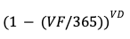
Example Operational Efficacy Analysis
Control: Access privileges
Intended Efficacy: 100%
Variant Efficacy: 0%
Variance Frequency (VF): 0.5 yr
Variance Duration (VD): 90 days
Operational Efficacy: 88%

Slide 26
Remember These Relationships?
Directly affect the frequency or magnitude of loss
Indirectly affect risk
Enable well-informed decisions
Asset management
Threat intelligence
Awareness training
Risk analysis
Etc.
Decision Support Functions
Authentication
Access privileges
Logging
Data recovery processes
Etc…
Assets
Loss Event Functions
Risk
Controls
Scanning
Patching
Auditing
Change management
Etc…
Variance Mgmt. Functions
Threats
Affect the reliability of other controls

Slide 27
What Drives Variance
Variance frequency and duration are a function of Variance Management and Decision Support controls (e.g., auditing, policies, training, testing, remediation, risk measurement, etc.)
Control #1 Operational Efficacy
Control #2 Operational Efficacy

Slide 28
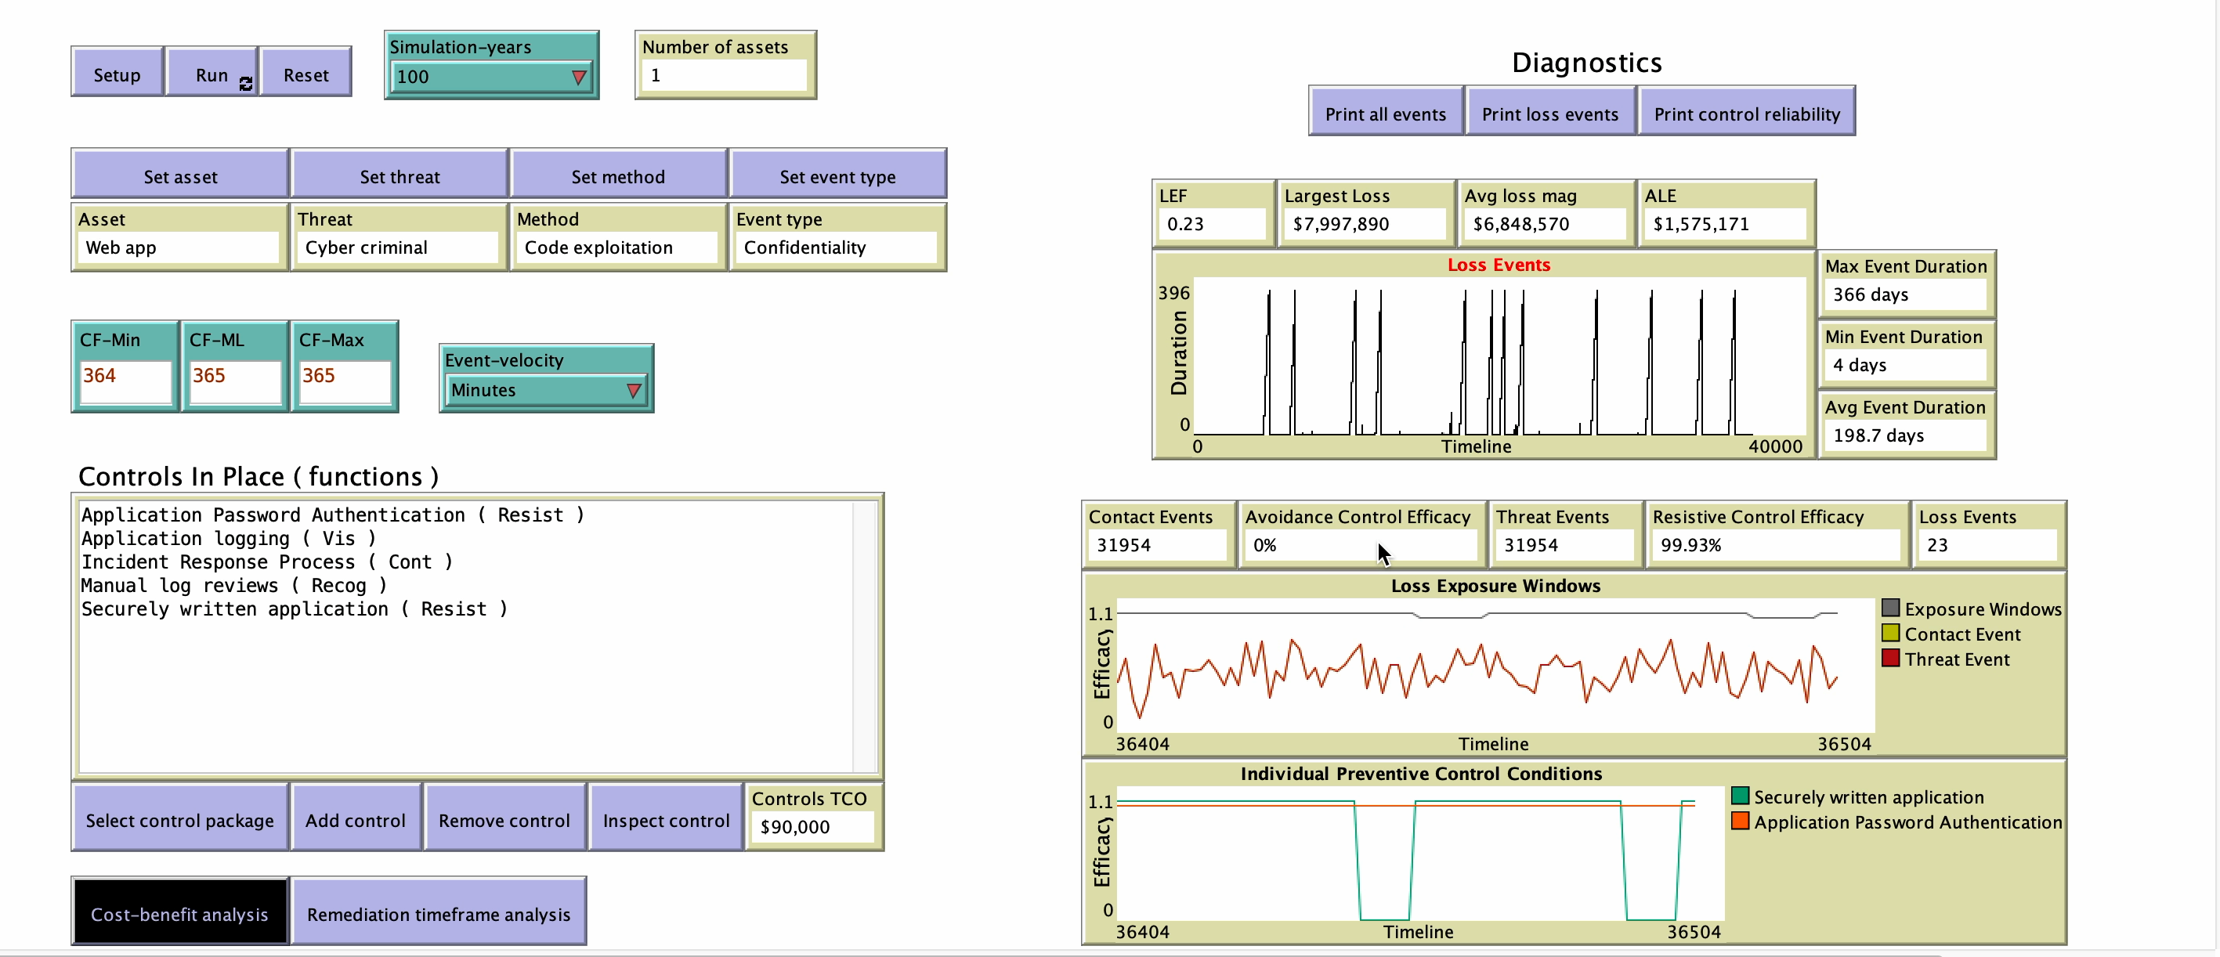
Cost-benefit analysis simulation

Slide 29
FAIR-CAM & Common Frameworks

Slide 30
FAIR-CAM is NOT a replacement for common control frameworks.
It helps us better understand and apply the controls within those frameworks.

Slide 31
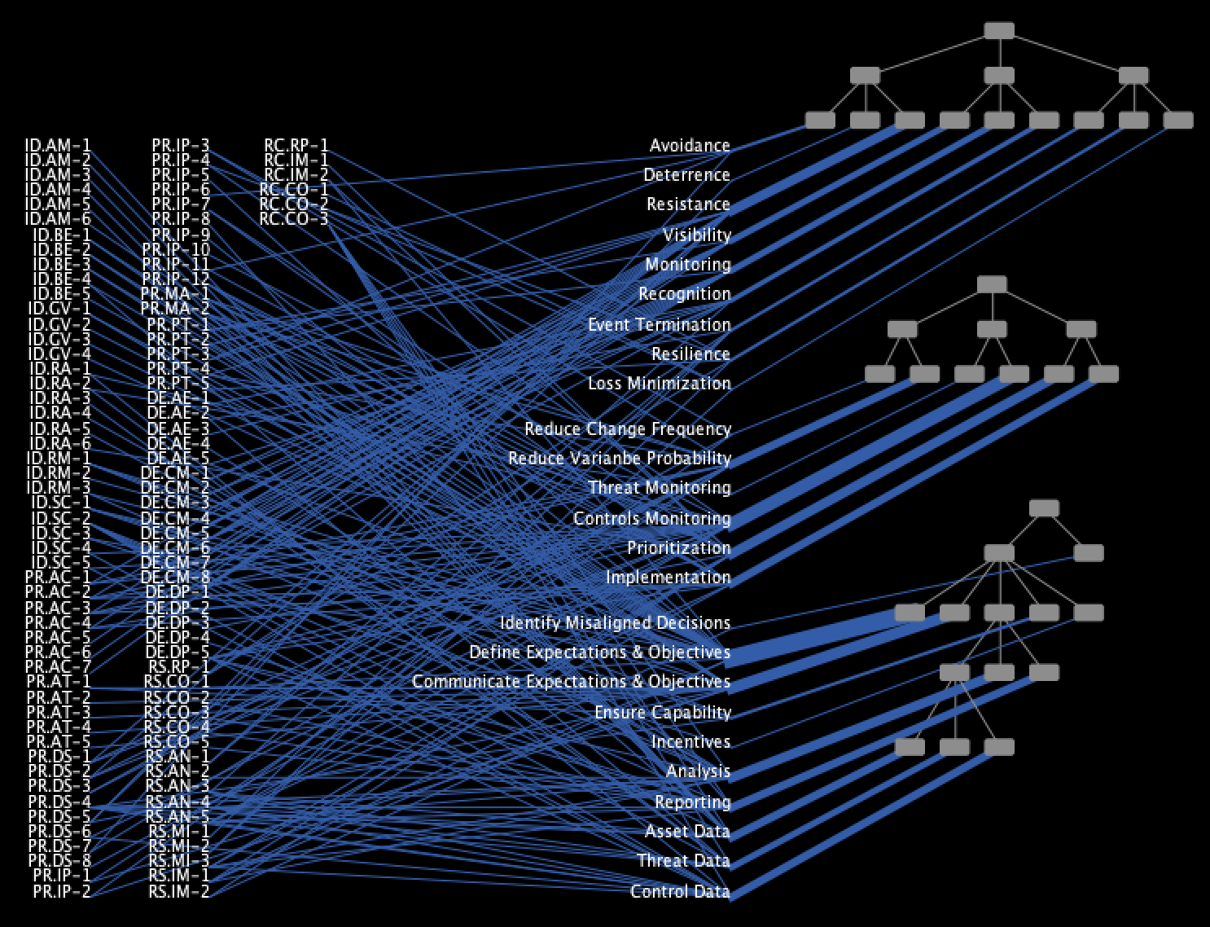
NIST-CSF to FAIR-CAM
NIST CSF Sub-categories
FAIR-CAM Control Function Names
Loss Event Control Functions
Mappings
Variance Management Control Functions
Decision Support Control Functions
Volume of mappings by control function

Slide 32
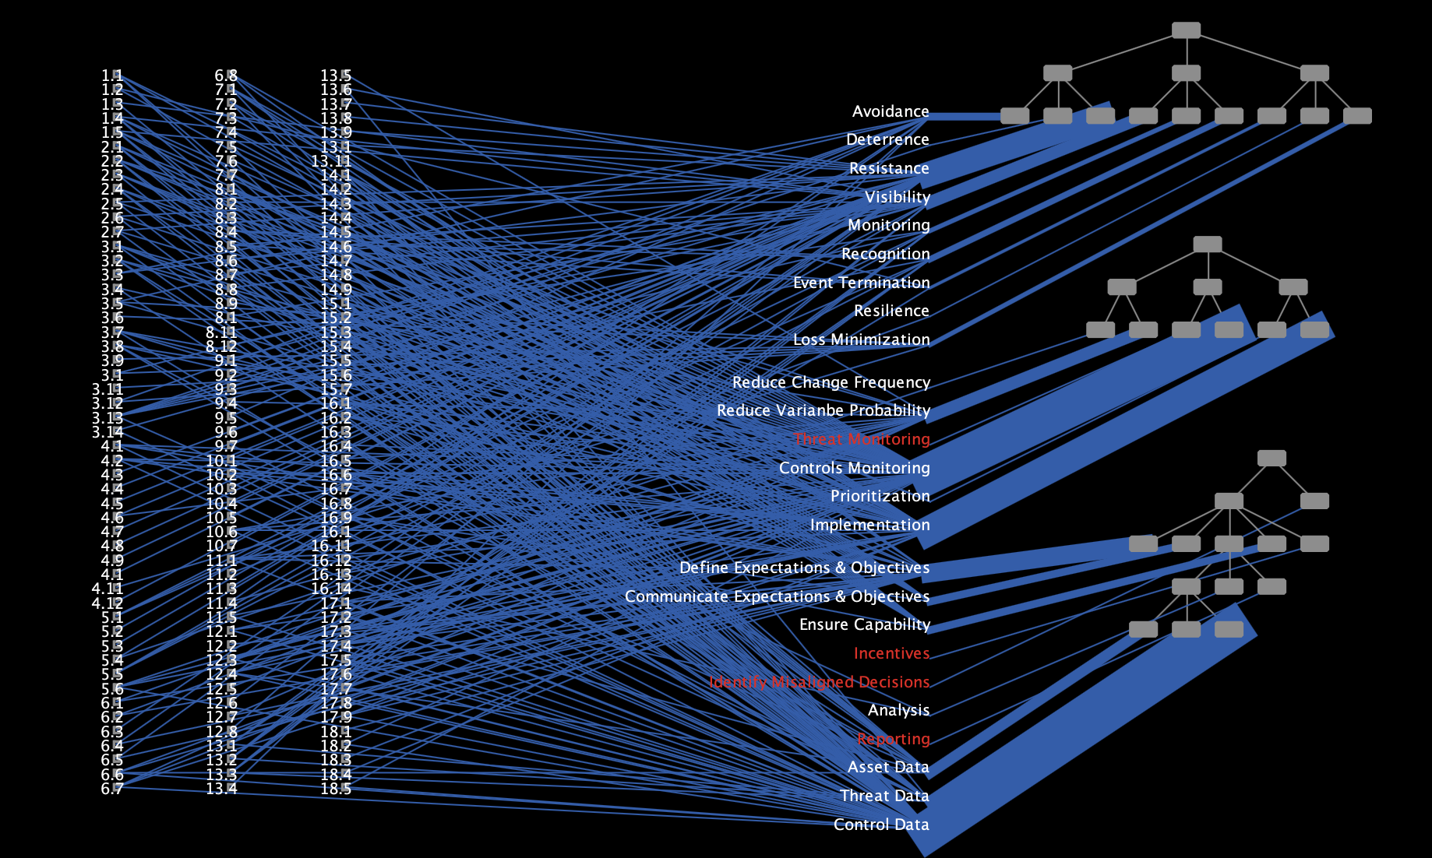
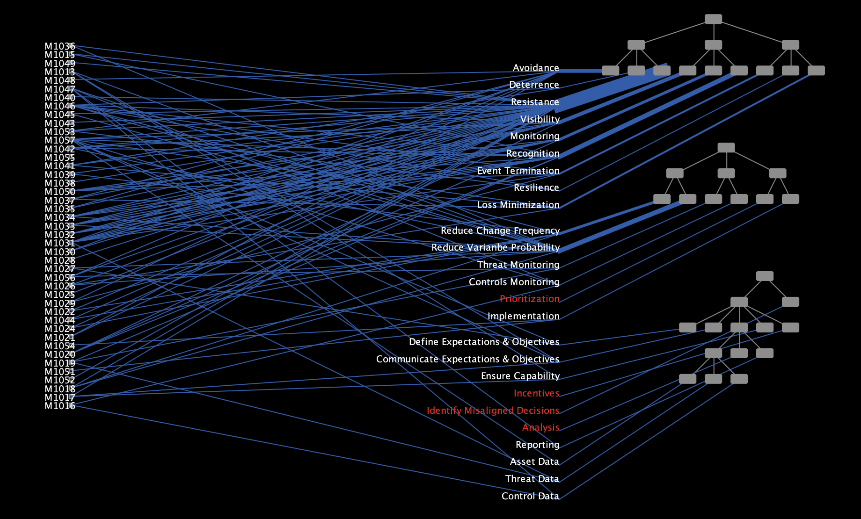
NIST CSF
CIS Controls
Mitre Mitigations

Slide 33
Wrapping up
Copyright 2023 RiskLens Inc. - CONFIDENTIAL

Slide 34
Key take-aways
Only understanding control “anatomy” doesn’t provide a complete picture of our risk posture
Overly-simplified approaches to control and risk measurement leads to poor decisions (poor prioritization and wasted resources)
FAIR-CAM reflects the complexity of our landscape
Holding our own against the threat actors requires us to understand and reliably measure the efficacy of our controls

Slide 35
QUESTIONS
Copyright 2023 RiskLens Inc. - CONFIDENTIAL

